Slide 1


INT254:
FUNDAMENTALS OF MACHINE LEARNING
Lecture 2

Slide 2
Introduction to Linear Algebra
in

Slide 3
Outline
1. Matrix arithmetic
2. Matrix properties
3. Eigenvectors & eigenvalues
-BREAK-
4. Examples (on blackboard)
5. Recap, additional matrix properties, SVD

Slide 4
Part 1: Matrix Arithmetic
(w/applications to neural networks)
In machine learning, from datasets to images all are often represented as matrices. Datasets are represented where each row corresponds to an instance or sample, and each column represents a feature or attribute of the data. This tabular representation allows efficient storage and processing of large datasets

Slide 5
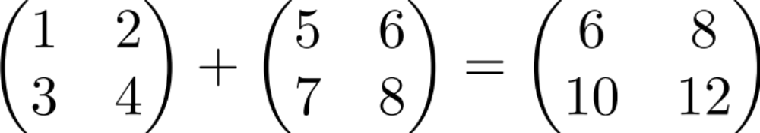
Matrix addition

Slide 6

Scalar times vector

Slide 7

Scalar times vector

Slide 8
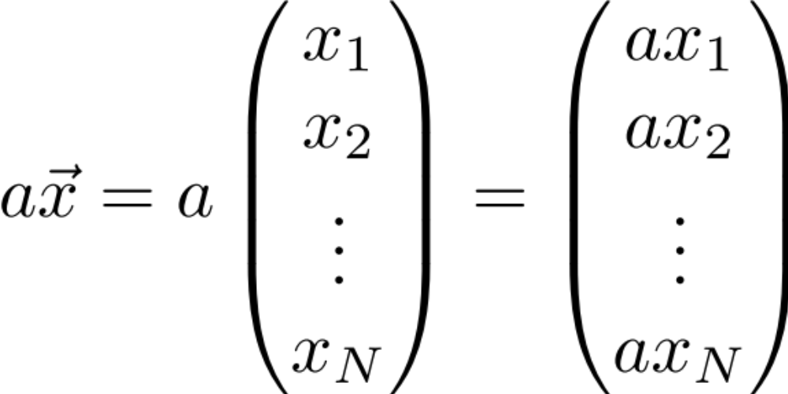
Scalar times vector

Slide 9
Product of 2 Vectors
Three ways to multiply
Element-by-element
Inner product
Outer product

Slide 10
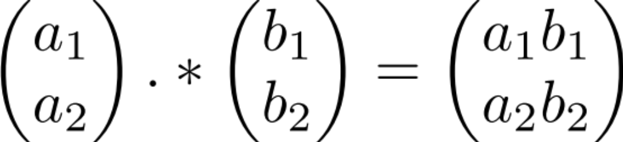
Element-by-element product (Hadamard product)
Element-wise multiplication (.* in MATLAB)

Slide 11
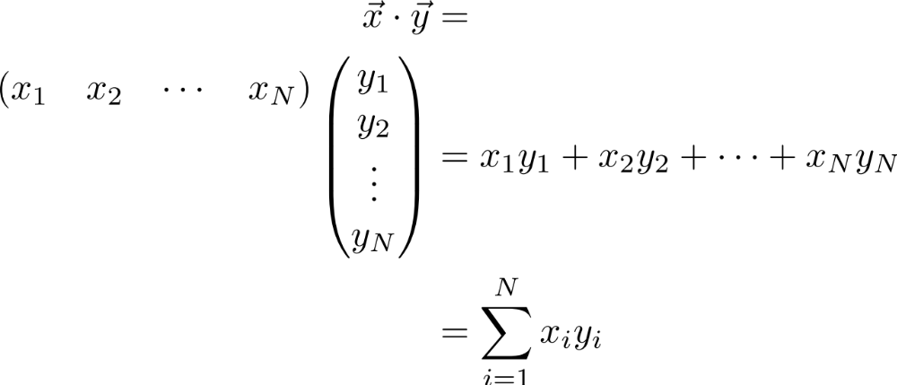
Multiplication:
Dot product (inner product)

Slide 12
Multiplication:
Dot product (inner product)

Slide 13
Multiplication:
Dot product (inner product)

Slide 14
Multiplication:
Dot product (inner product)

Slide 15
Multiplication:
Dot product (inner product)
1 X N
N X 1
1 X 1
Outer dimensions give
size of resulting matrix

Slide 16
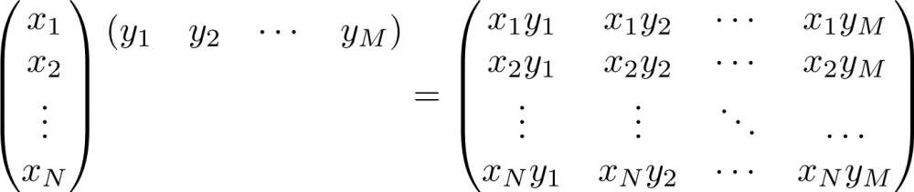
Multiplication: Outer product
N X 1
1 X M
N X M

Slide 17
Multiplication: Outer product

Slide 18
Multiplication: Outer product

Slide 19
Multiplication: Outer product

Slide 20
Multiplication: Outer product

Slide 21
Multiplication: Outer product

Slide 22

Multiplication: Outer product

Slide 23
Multiplication: Outer product
Note: each column or each row is a multiple of the others
Notes:
We’ll see implications of this feature shortly… (motivation for “rank 1”/1-dimensional matrix) and also underlying components of SVD

Slide 24
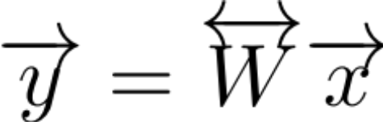
Matrix times a vector

Slide 25
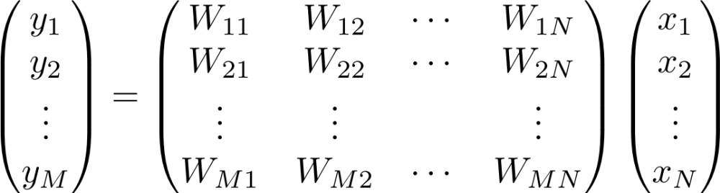
Matrix times a vector

Slide 26
Matrix times a vector
M X 1
M X N
N X 1

Slide 27
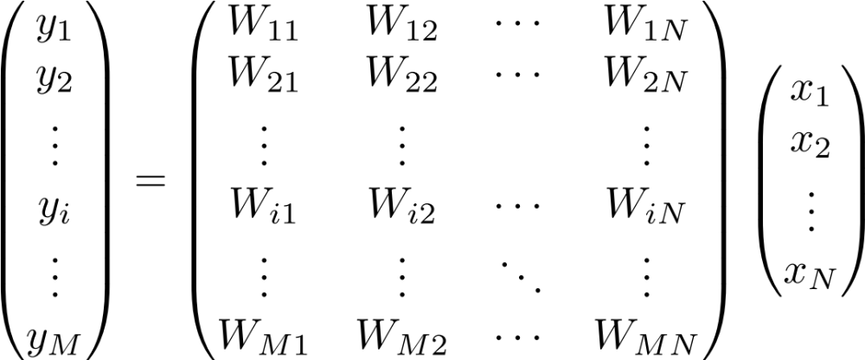
Matrix times a vector:
inner product interpretation
Rule: the i^{th} element of y is the dot product of the i^{th} row of W with x

Slide 28
Matrix times a vector:
inner product interpretation
Rule: the i^{th} element of y is the dot product of the i^{th} row of W with x

Slide 29
Matrix times a vector:
inner product interpretation
Rule: the i^{th} element of y is the dot product of the i^{th} row of W with x

Slide 30
Matrix times a vector:
inner product interpretation
Rule: the i^{th} element of y is the dot product of the i^{th} row of W with x

Slide 31
Matrix times a vector:
inner product interpretation
Rule: the i^{th} element of y is the dot product of the i^{th} row of W with x

Slide 32

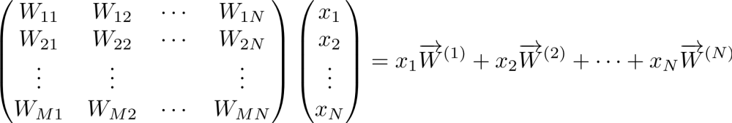
Matrix times a vector:
outer product interpretation
The product is a weighted sum of the columns of W, weighted by the entries of x

Slide 33
Matrix times a vector:
outer product interpretation
The product is a weighted sum of the columns of W, weighted by the entries of x

Slide 34
Matrix times a vector:
outer product interpretation
The product is a weighted sum of the columns of W, weighted by the entries of x

Slide 35
Matrix times a vector:
outer product interpretation
The product is a weighted sum of the columns of W, weighted by the entries of x

Slide 36

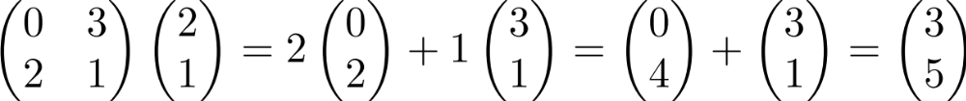
Example of the outer product method

Slide 37
Example of the outer product method
(0,2)
(3,1)

Slide 38
Example of the outer product method
(0,4)
(3,1)

Slide 39
Example of the outer product method
(3,5)
Note: different combinations of the columns of M can give you any vector in the plane
(we say the columns of M
“span” the plane)

Slide 40
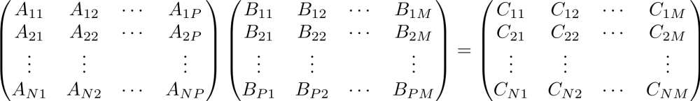
Product of 2 Matrices
N X P
P X M
N X M
MATLAB: ‘inner matrix dimensions must agree’
Note: Matrix multiplication doesn’t (generally) commute, AB ≠ BA

Slide 41
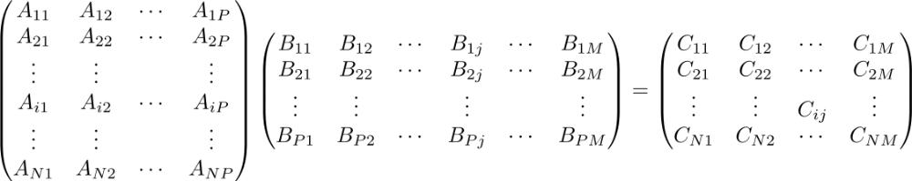
Matrix times Matrix:
by inner products
C_{ij} is the inner product of the i^{th} row with the j^{th} column

Slide 42
Matrix times Matrix:
by inner products
C_{ij} is the inner product of the i^{th} row with the j^{th} column

Slide 43
Matrix times Matrix:
by inner products
C_{ij} is the inner product of the i^{th} row with the j^{th} column

Slide 44
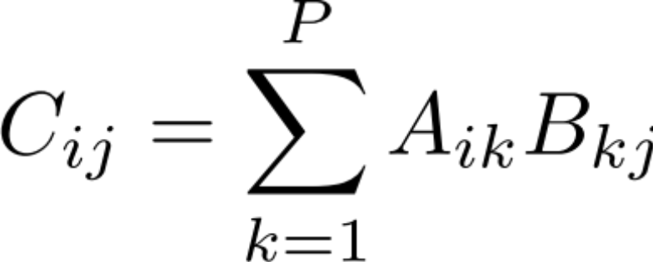
Matrix times Matrix:
by inner products
C_{ij} is the inner product of the i^{th} row of A with the j^{th} column of B

Slide 45
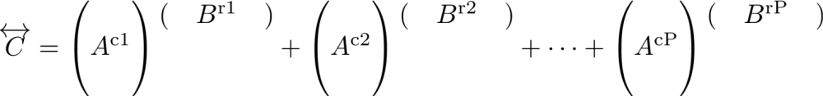
Matrix times Matrix:
by outer products

Slide 46
Matrix times Matrix:
by outer products

Slide 47
Matrix times Matrix:
by outer products

Slide 48
Matrix times Matrix:
by outer products
C is a sum of outer products of the columns of A with the rows of B
Notes:
Note: this way of matrix multiplying, i.e. breaking into outer products is key to Singular Value Decomposition (SVD) which I’ll discuss at end of lecture; note that each outer product is rank 1 since each column (or row) is a multiple of every other column (or row)

Slide 49
Part 2: Matrix Properties
(A few) special matrices
Matrix transformations & the determinant
Matrices & systems of algebraic equations

Slide 50
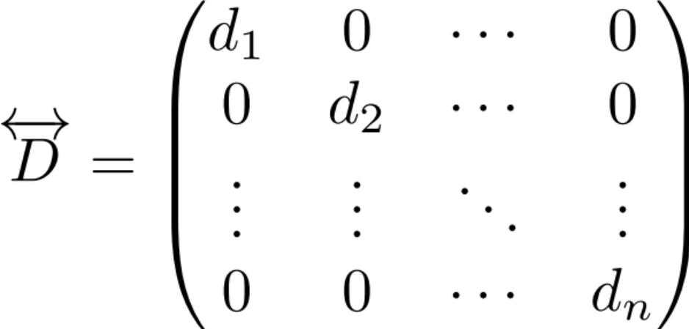
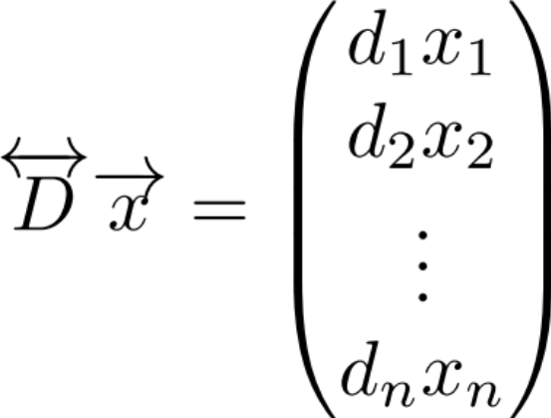
Special matrices: diagonal matrix
This acts like scalar multiplication

Slide 51
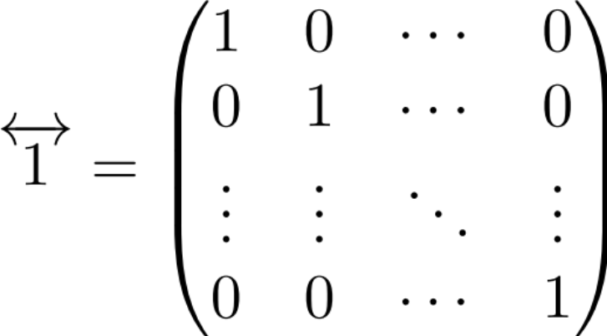
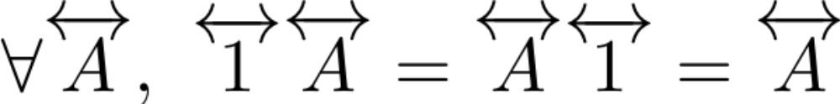
Special matrices: identity matrix
for all

Slide 52
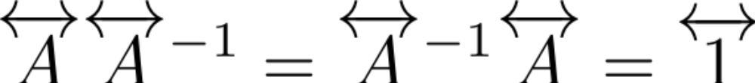
Special matrices: inverse matrix
Notes:
For scalars, there is no inverse if the scalar’s value is 0. For matrices, the corresponding quantity that has to be nonzero for the inverse to exist is called the determinant, which we’ll show next corresponds geometrically (up to a sign) to an area (or, in higher dimensions, volume).

Slide 53
How does a matrix transform a square?
(0,1)
(1,0)

Slide 54
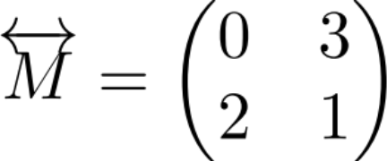
How does a matrix transform a square?
(0,1)
(1,0)

Slide 55
How does a matrix transform a square?
(0,2)
(0,1)
(3,1)
(1,0)
Notes:
Note, potentially a bit confusing: the vector (1,0) got mapped into (0,2) and (0,1) got mapped into (3,1): this relates to fact that determinant is negative (i.e. in some sense, orientation of parallelogram flipped)

Slide 56
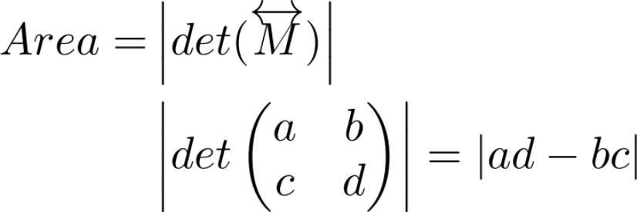
Geometric definition of the determinant: How does a matrix transform a square?
(0,1)
(1,0)

Slide 57
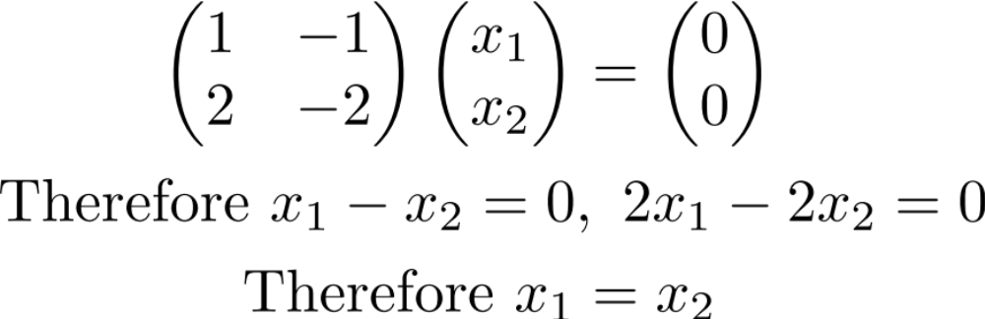
Example of an underdetermined system
Some non-zero vectors are sent to 0

Slide 58
Example of an underdetermined system
Some non-zero vectors are sent to 0

Slide 59
Example of an underdetermined system

Slide 60
Example of an underdetermined system
Some non-zero x are sent to 0 (the set of all x with Mx=0 are called the “nullspace” of M)
This is because det(M)=0 so M is not invertible. (If det(M) isn’t 0, the only solution is x = 0)
Notes:
c

Slide 61
Part 3: Eigenvectors & eigenvalues

Slide 62
What do matrices do to vectors?
(0,2)
(2,1)
(3,1)

Slide 63
Recall
(3,5)
(2,1)

Slide 64
What do matrices do to vectors?
(3,5)
The new vector is:
1) rotated
2) scaled
(2,1)

Slide 65
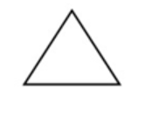
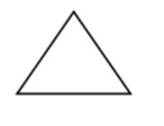

Are there any special vectors
that only get scaled?
It is used to alter or change the size of objects. The change is done using scaling factors. There are two scaling factors, i.e. Sx in x direction Sy in y-direction.

Slide 66
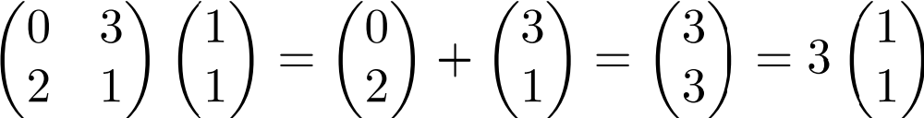
Are there any special vectors
that only get scaled?
Try (1,1)

Slide 67
Are there any special vectors
that only get scaled?
= (1,1)

Slide 68
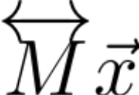
Are there any special vectors
that only get scaled?
= (3,3)
= (1,1)

Slide 69
Are there any special vectors
that only get scaled?
For this special vector, multiplying by M is like multiplying by a scalar.
(1,1) is called an eigenvector of M
3 (the scaling factor) is called the eigenvalue associated with this eigenvector
= (3,3)
= (1,1)

